Slide 1
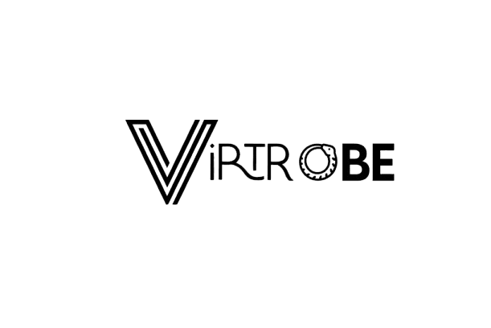



Virtual Wardrobe

Slide 2



G4 - Virtual Try-On and Intelligent Wardrobe Management Solution

Slide 3
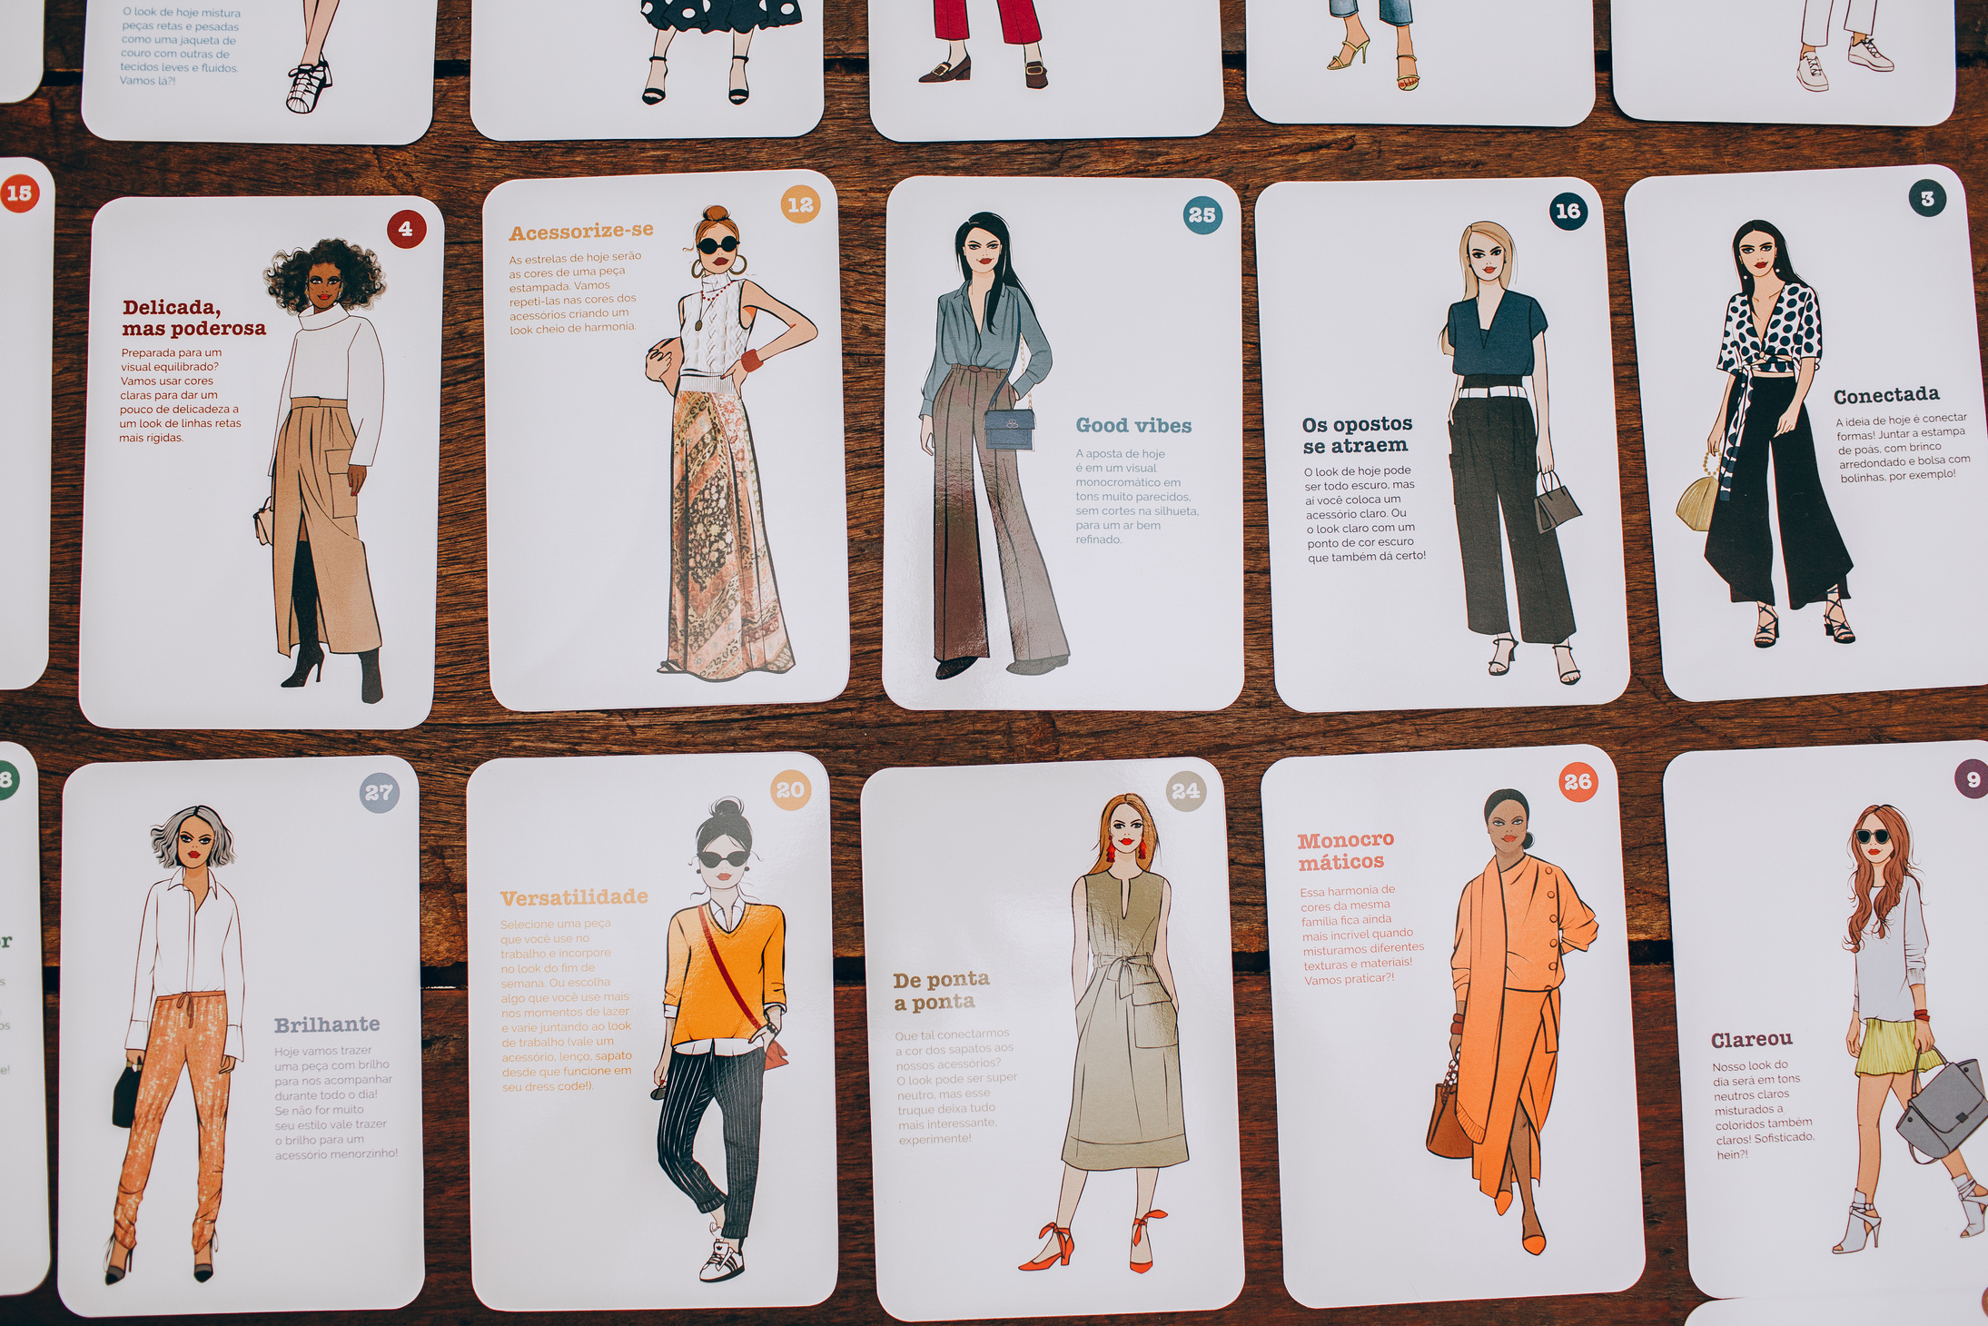



Introduction & Background
The retail industry is evolving due to urbanization, changing consumer trends, and the growth of e-commerce.
Shoppers face issues such as long fitting room waits and limited virtual try-on experiences.
VirtRobe, a virtual wardrobe app, addresses these challenges using pose estimation and homography.
Features include avatar creation, outfit tracking, personalized suggestions, and social sharing to enhance the shopping experience.

Slide 4










AVATARS

Slide 5
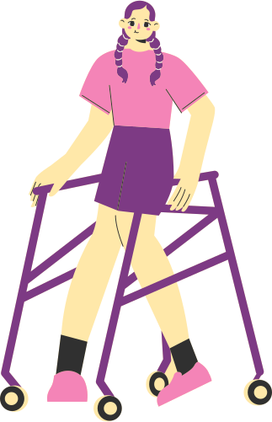






Features
Virtual Closet: Users can view their wardrobe filtered by occasion, weather, and style for easy access.
Avatar with Virtual Try-On: Users create a digital avatar for virtual try-ons, with image processing ensuring accurate body representation, including dedicated features for specially-abled users.
Live Try-On: Users can virtually try on items from their own closet through a live video feed, bringing their wardrobe to life.
Chatbot Assistance: A chatbot provides style advice, real-time weather updates, and outfit suggestions.

Slide 6




FLOWCHART
ChatBot
(NLP &
Gemini API)
Live Camera Feed
premeditated
Avatar
Outfit Suggestion
Face Segmentation
remove.bg API
remove.bg API
Overlay on Avatar

Slide 7
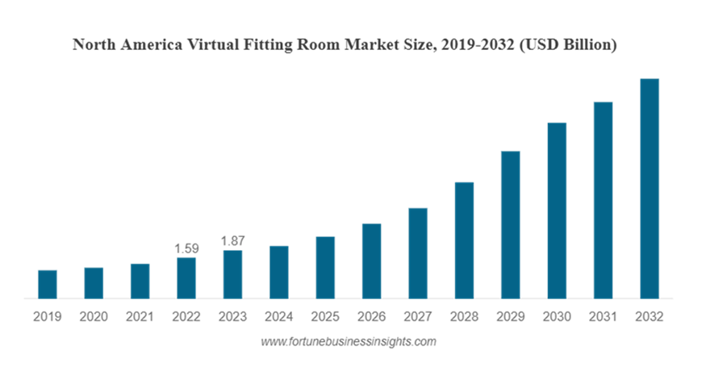

Market Scope & Growth Drivers
GLOBAL TRENDS
INDIA SPECIFIC
GROWTH DRIVERS
Target Audience: 400M middle- and upper-middle-class urban consumers.
E-commerce Growth: Indian fashion market set to grow from $38.5B (2023) to $118B (2026).
Mobile Penetration: 74% smartphone usage driving mobile commerce adoption.
Mobile Commerce: Platforms like Amazon & Myntra exploring virtual try-ons.
Social Media: Instagram and Pinterest influencing consumer preferences, especially with Gen Z and millennials.
AR Market: Virtual fitting rooms forecasted to grow from $4.79B (2023) to $25.11B (2032) (CAGR: 20.3%)
71% of consumers prefer AR-enhanced shopping experiences.
AR in retail projected to grow from $1.1B (2022) to $12B (2025) (CAGR: 80%).
Key markets: U.S., Europe, India (urban population to hit 600M by 2031).

Slide 8


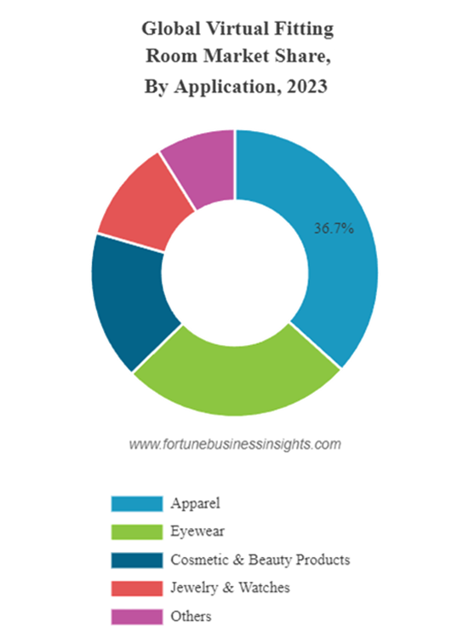


Applications
Customer Experience: Reduces trial room wait times by 60%; virtual try-ons could lower e-commerce return rates by 20%, saving logistics costs
Operational Efficiency: Mobile-based virtual trial solutions cost $5,000–10,000, compared to $20,000–50,000 for traditional virtual mirrors.
Market Potential
Demand for personalization & sustainability: VTRs can increase revenue by 10% for retailers.
Sustainability: Reduces inventory and returns, aligning with environmental goals.
Recommendations
Retailer Partnerships: Collaborate with Indian brands (Reliance Trends, Lifestyle) for greater engagement.
E-commerce Collaboration: Partner with Flipkart, Myntra, Amazon to reduce return rates and improve customer satisfaction.

Slide 9
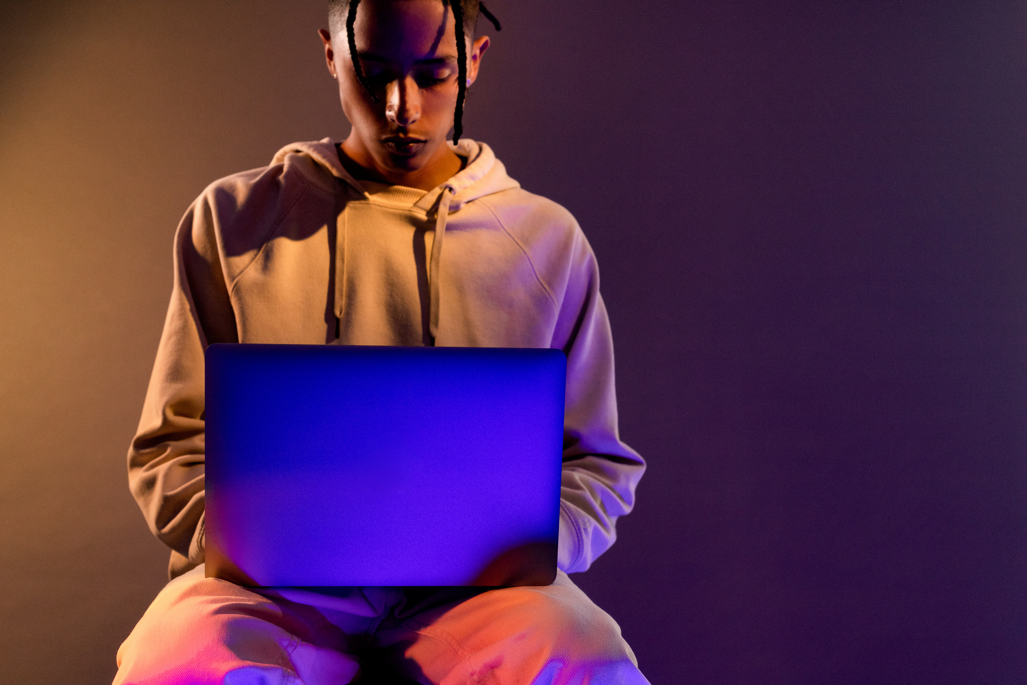

References
www.fortunebusinessinsights.com
www.researchgate.net
www.arxiv.org
www.fablstyle.com
www.getwardrobe.com

